Slide 1
Supplementary HPV slides for Paul
18 May 2015
joseph.brew@flhealth.gov

Slide 2
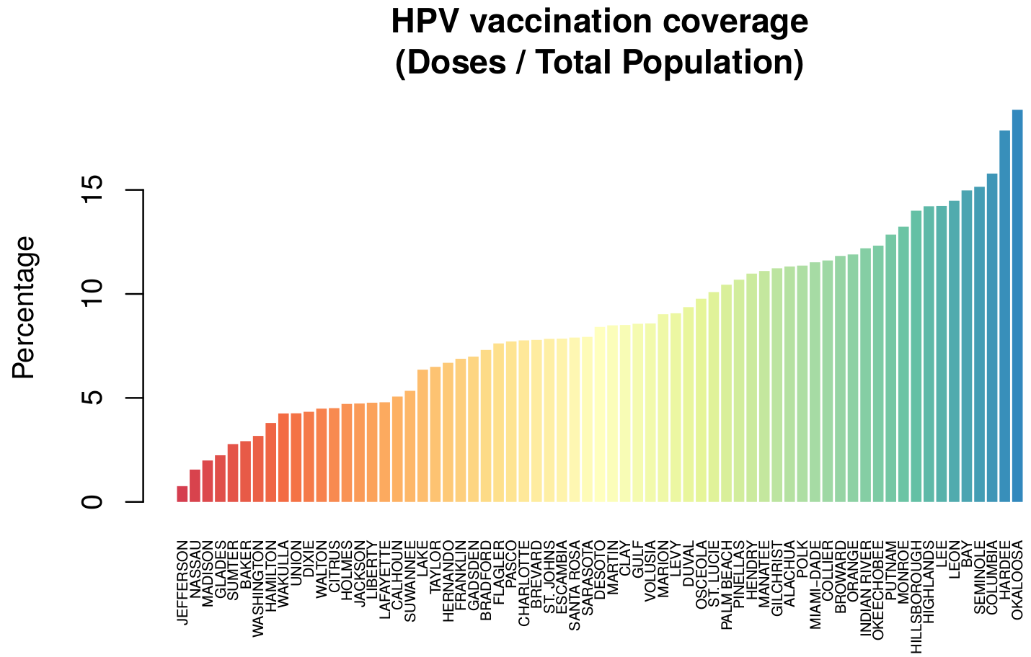

Slide 3
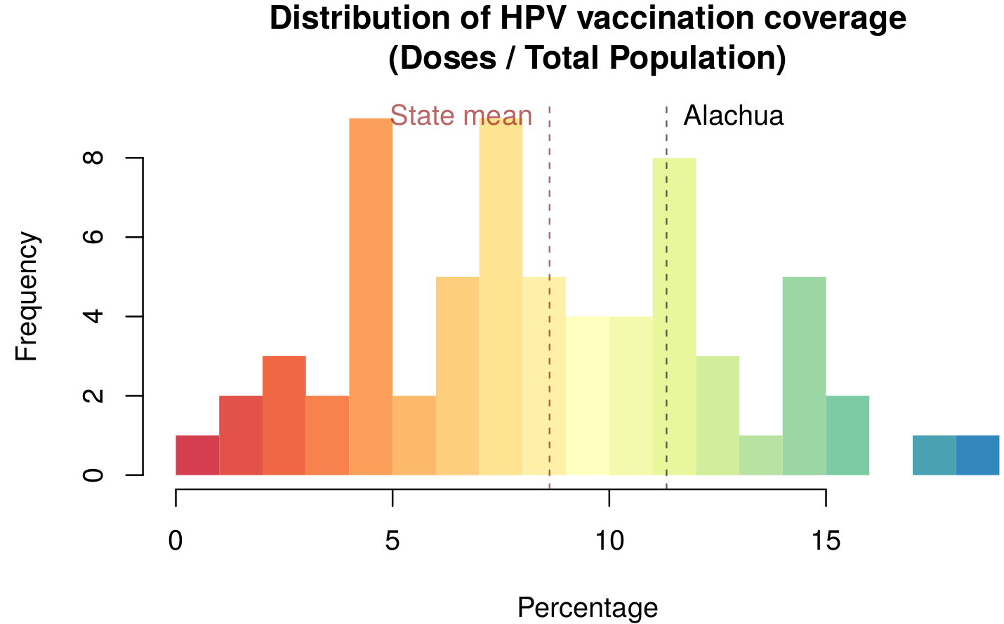

Slide 4
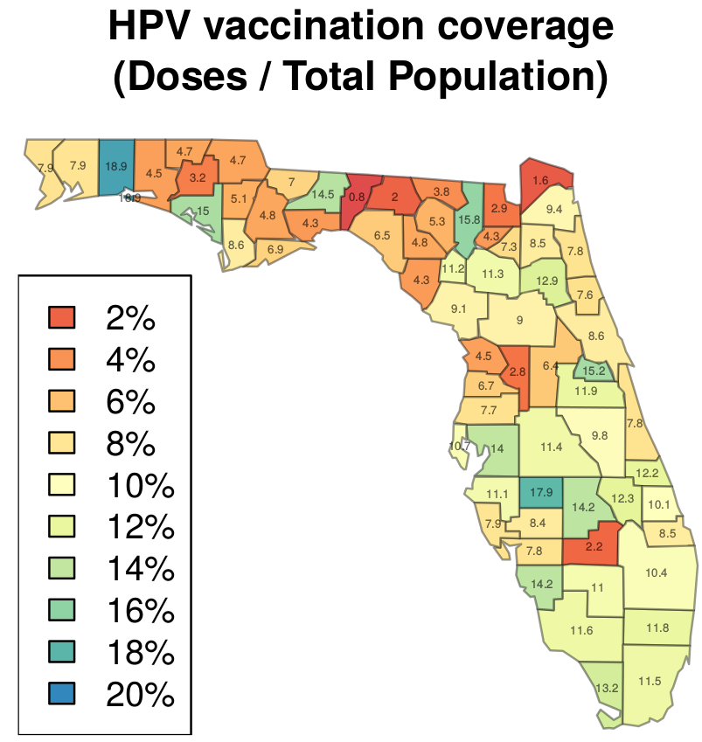

Slide 5
Per FlShots, Alachua is ranked 19th of 67 counties in regards to HPV vaccination coverage (all age groups).
Alachua = 11.32%
(28,000 of 247,336)
Florida = 10.75%
(2,022,328 of 18,801,310 )

